Slide 1




HackOrbit 2025
BUG_BUSTERS

Slide 2

EcoCart – Sustainable Shopping Assistant
For a Greener and Smarter Shopping Experience
By Bug_Busters:-
Arihant Jain
arihantjainwebdev@gmail.com
Aditya Rajpoot
adityarajpoot656@gmail.com
Aarjav Jain
aarjav316@gmail.com

Slide 3
The Problem
• Consumers unknowingly purchase products from unsustainable brands
• These include excess packaging, fast fashion, and unethical labor
• No real-time eco information while shopping online

Slide 4
PROPOSED SOLUTION
• Chrome Extension + Web Dashboard
• Displays eco-scores, certifications, and sustainability badges
• Recommends greener alternatives
• Tracks user’s eco-impact: carbon saved, plastic avoided

Slide 5
FEATURES AND NOVELTY
🧩 Chrome Extension – Auto-scans shopping pages for sustainability info
🟢 Eco-Score Badge – Shows eco-friendliness of products
🔄 Greener Alternatives – Suggests more sustainable products
📊 Dashboard – Tracks your sustainable shopping progress
🔍 Product Search – Manually compare multiple items
🌐 Sustainable Brands Directory – Curated eco-friendly companies

Slide 6
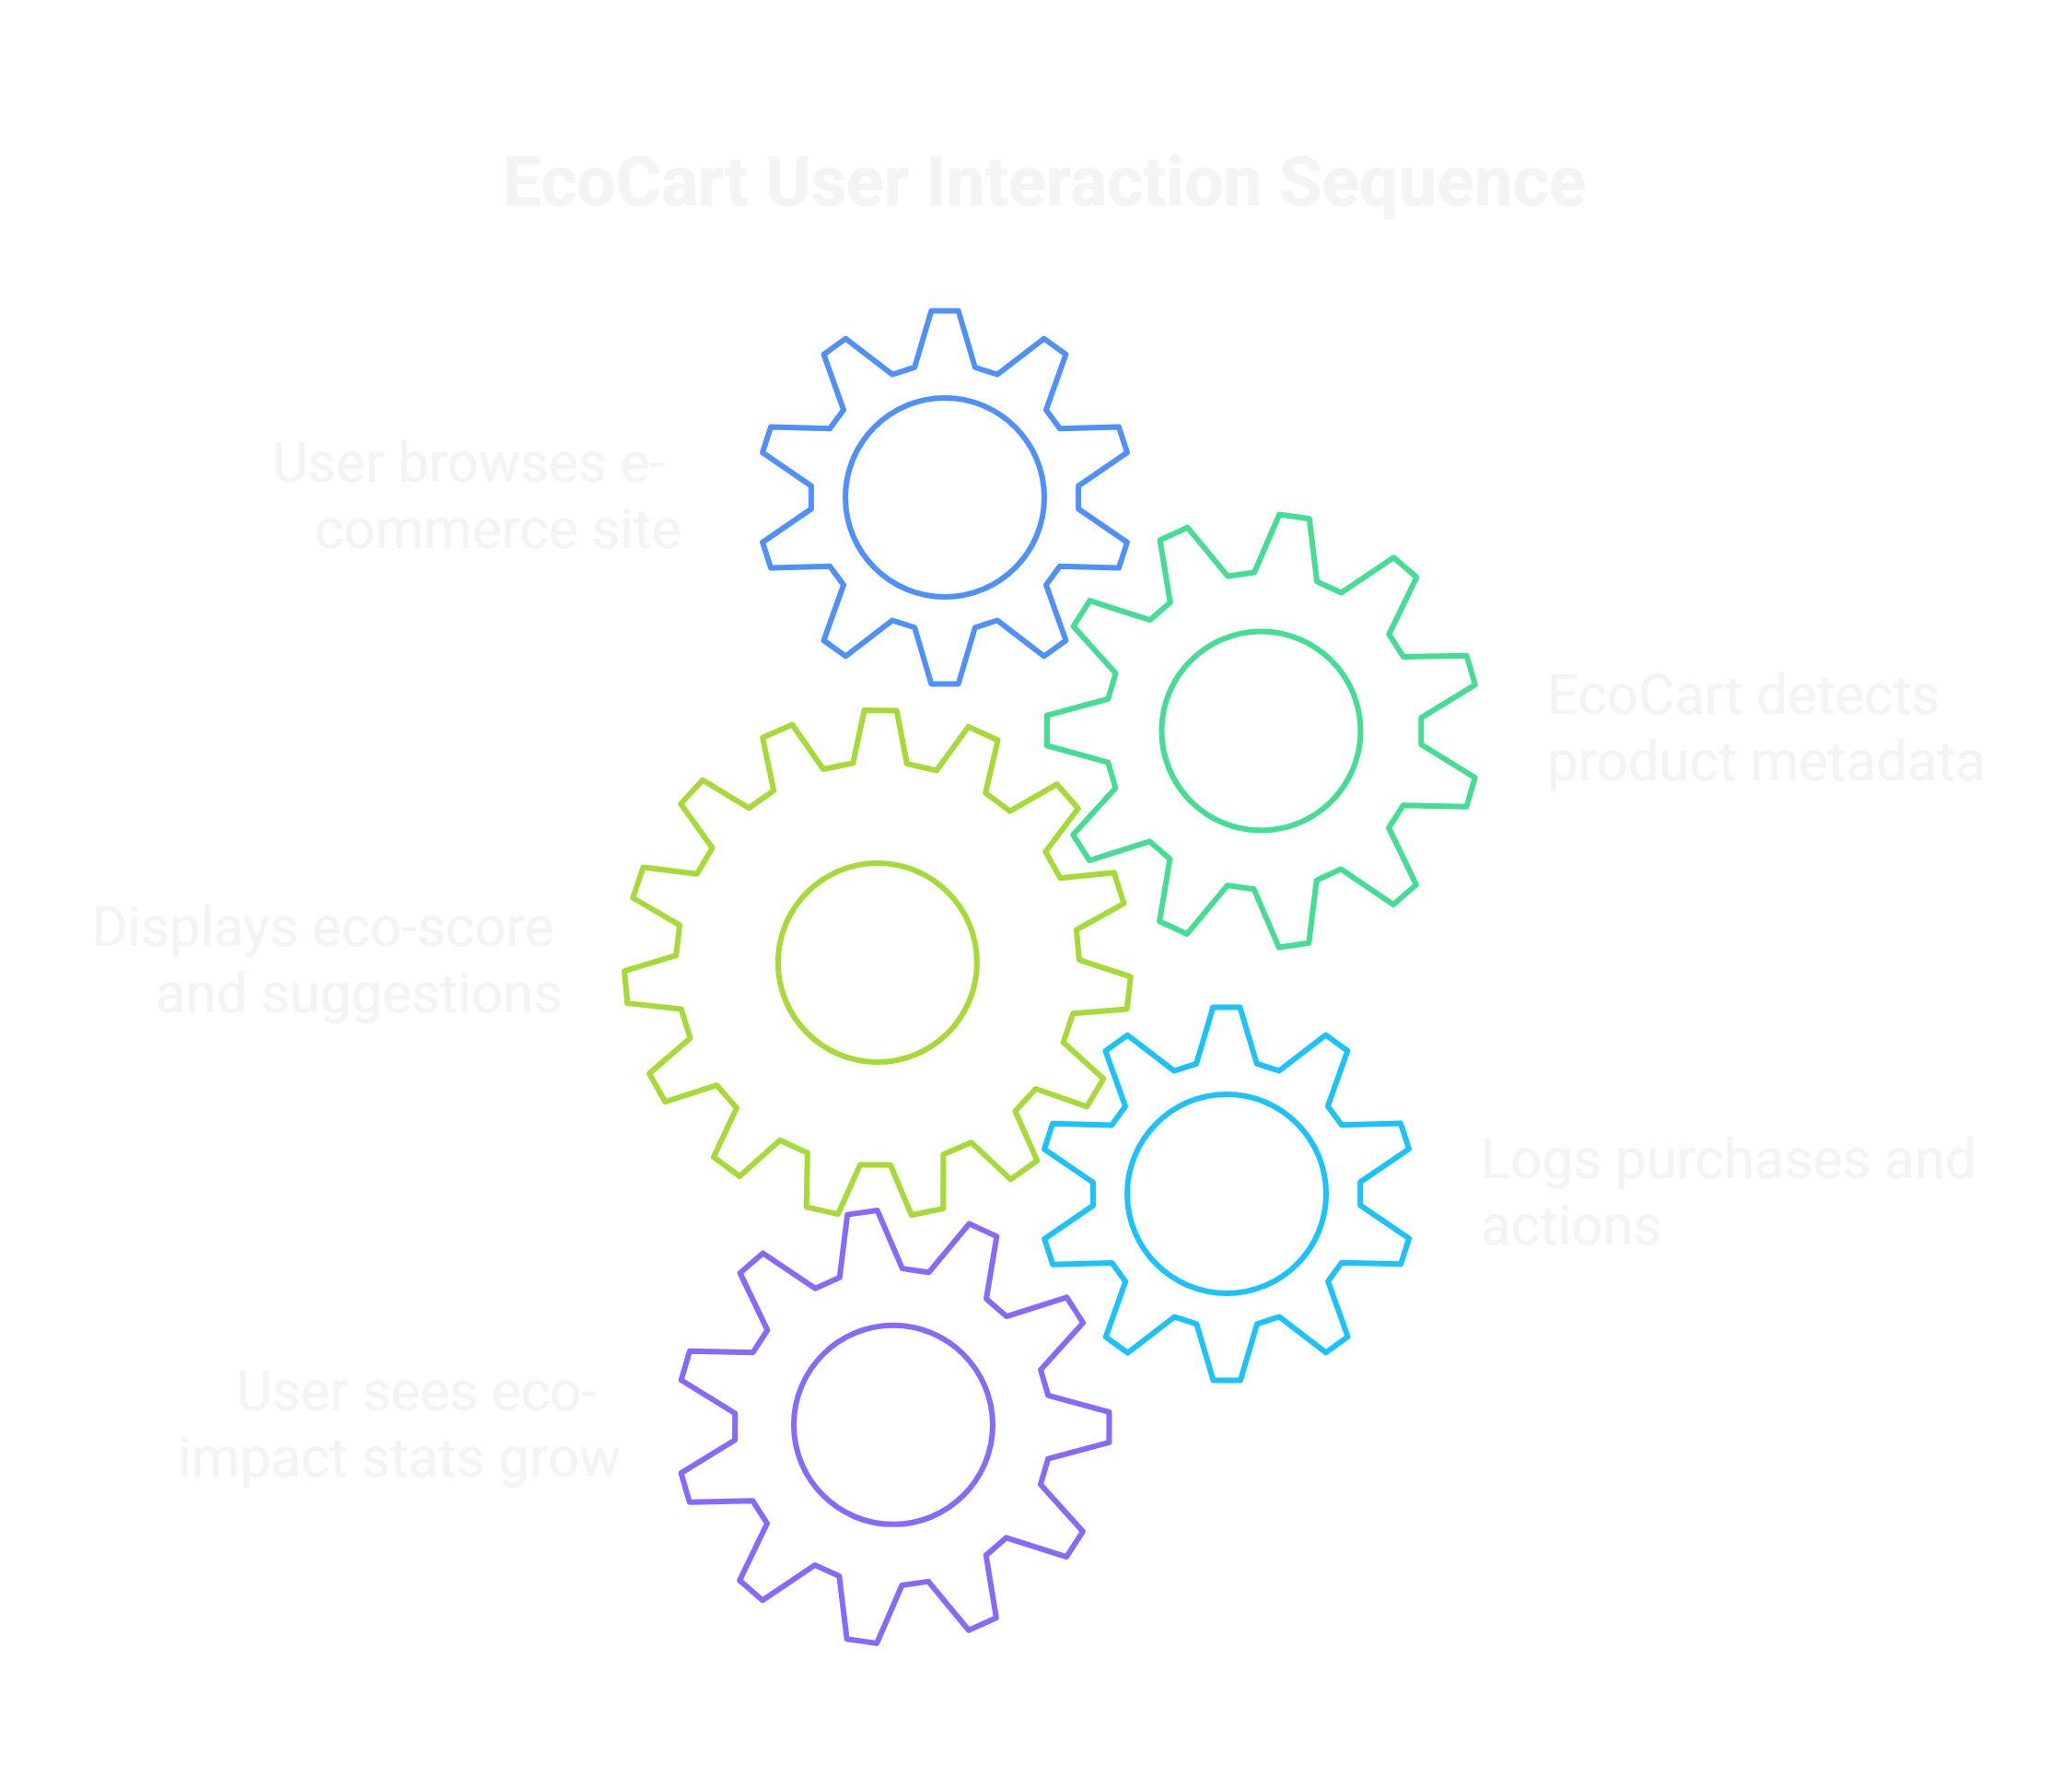
FLOWCHART / DIAGRAM
How It Works

Slide 7
Tech Stack
🌐 Frontend:
JavaScript Chrome Extension
React.js or Next.js (Dashboard)
Tailwind CSS
🔄 Backend & Data:
Node.js + Express or Flask
MongoDB / Firebase for user & product data
Sustainability data APIs, scraping
🤖 Optional Enhancements:
ChatGPT API for product tips
ML for product category detection

Slide 8
Data Sources for Eco-Scores
• Product packaging info (scraped or user-submitted)
• Sustainability Certifications (FSC, USDA Organic, Fair Trade, etc.)
• Brand Environmental Reports
• Public APIs like:
– Carbon Interface API
– Barcode Lookup API

Slide 9
DRAWBACK AND SHOWSTOPPERS
🔍 Data Accuracy & Availability :
Sustainability data may be incomplete, outdated, or inconsistent across products and brands.
🧷 Dependence on External APIs :
Relying on third-party sources (e.g., Carbon Interface API, barcode lookup) introduces reliability risks.
🛒 Platform Compatibility Limits :
Initially may only work on popular sites like Amazon, Flipkart, etc. Not all sites have a consistent structure for scraping
.💾 Browser-Only Use :
Chrome Extension limits access for mobile users unless separately built.
🧠 User Overload or Disinterest :
Some users may ignore eco-scores if not presented engagingly or if too technical.
🧑‍💻 Maintenance Overhead :
Continuous updates needed as e-commerce sites change their layout/structure.

Slide 10
Let’s Build a Greener Future Together! 🌱
Thank you

